Slide 1
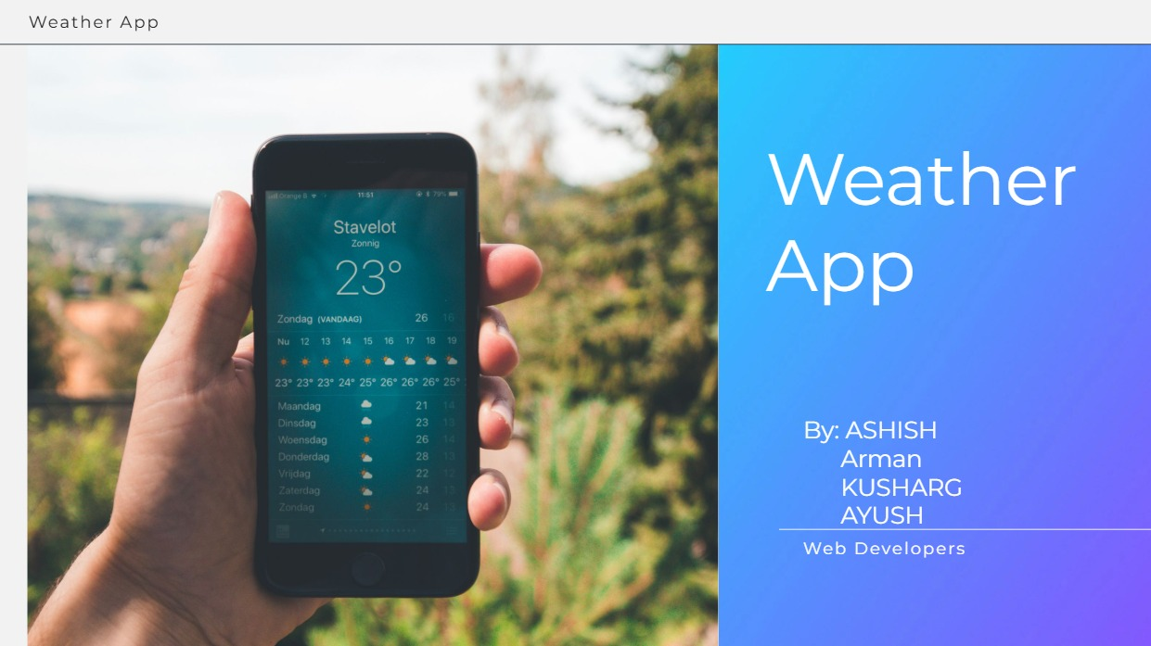

Slide 2
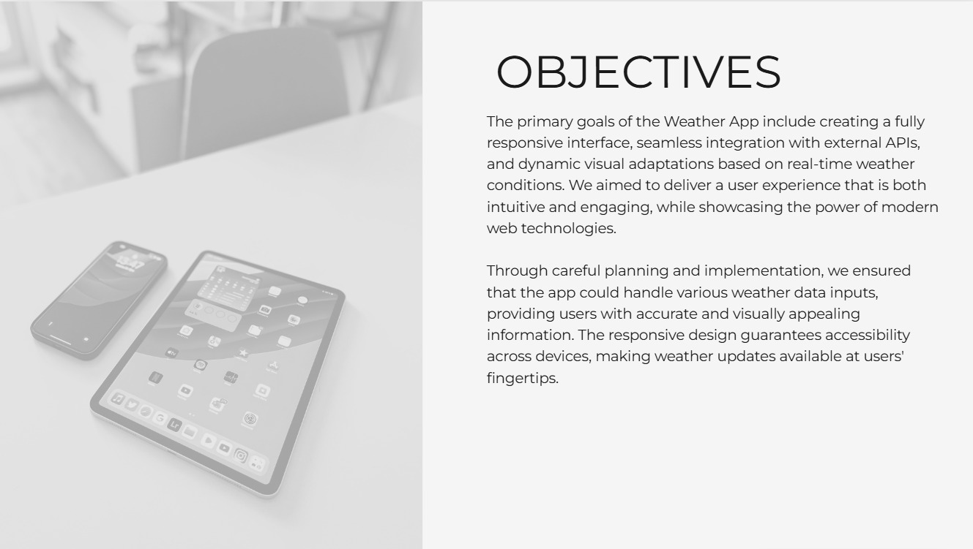
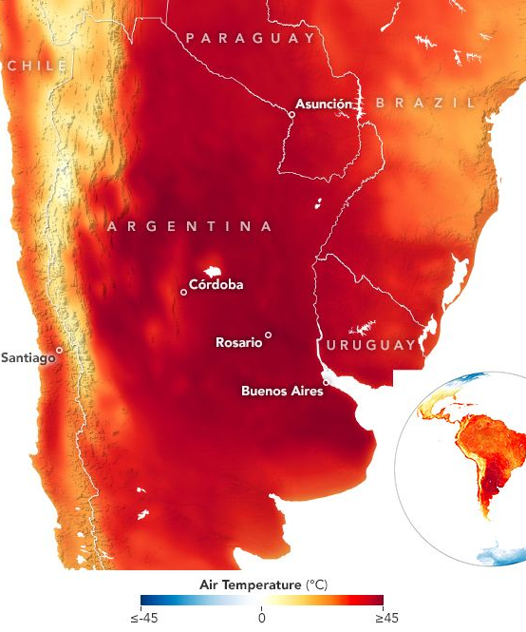
Global warming
The impacts of global warming are severe and widespread. Glaciers and ice sheets are shrinking, sea levels are rising, and extreme weather events such as heatwaves, droughts, and intense hurricanes are becoming more frequent and intense. For instance, the Greenland and Antarctic ice sheets have lost billions of tons of ice per year since 1993. Additionally, the ocean has absorbed much of this increased heat, leading to warming of the top 100 meters of ocean by 0.67 degrees Fahrenheit since 1969.

Slide 3

The IMPACT of WEATHER

Slide 4
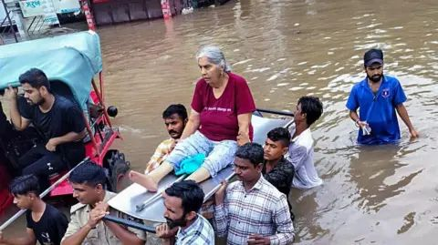
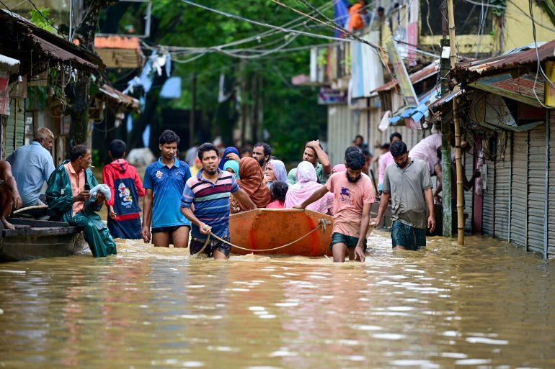
In August 2024, intense rainfall led to severe flooding in Gujarat, resulting in at least 28 deaths and the evacuation of over 24,000 people across approximately 300 districts.
The monsoon season brought severe flooding to Assam, affecting over 400,000 people and inundating more than 1,300 villages across 19 districts. The floods resulted in at least 109 deaths.

Slide 5
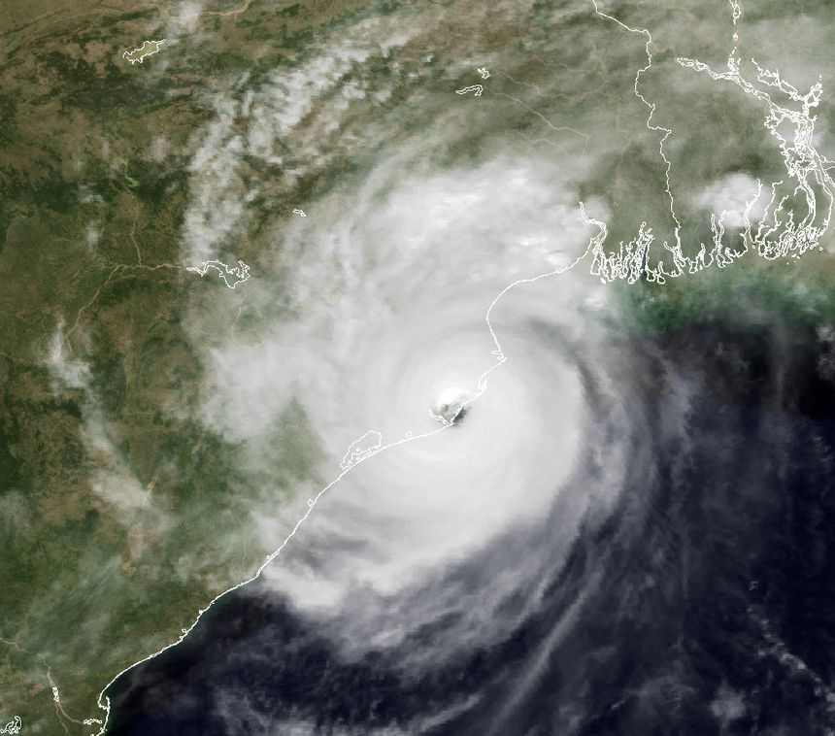
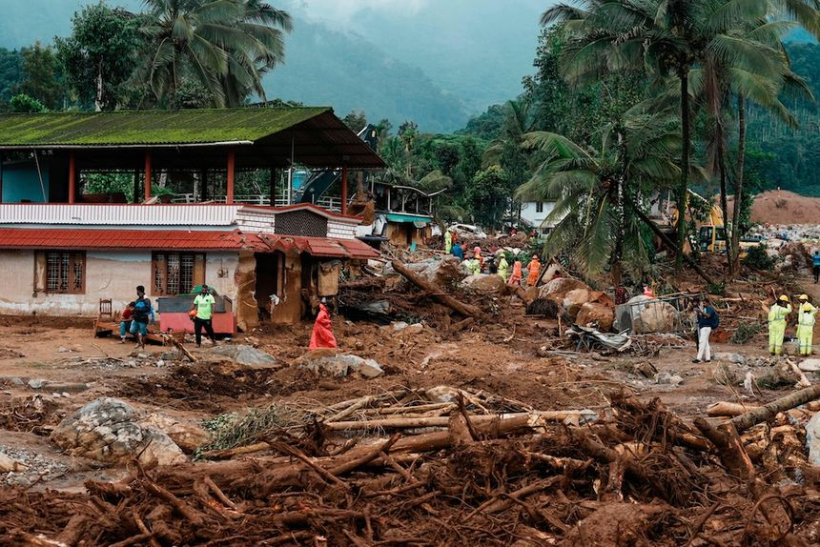
In November 2024, Cyclone Fengal made landfall near Puducherry, leading to at least 19 fatalities. The cyclone brought heavy rains and strong winds, causing damage to homes, power lines, and uprooting trees, thereby disrupting daily life in the affected regions.
IN JUNE 2024, HEAVY MONSOON RAINS TRIGGERED DEVASTATING LANDSLIDES IN KERALA'S WAYANAD DISTRICT. THE DISASTER CLAIMED OVER 400 LIVES, WITH MANY MORE INJURED OR MISSING

Slide 6
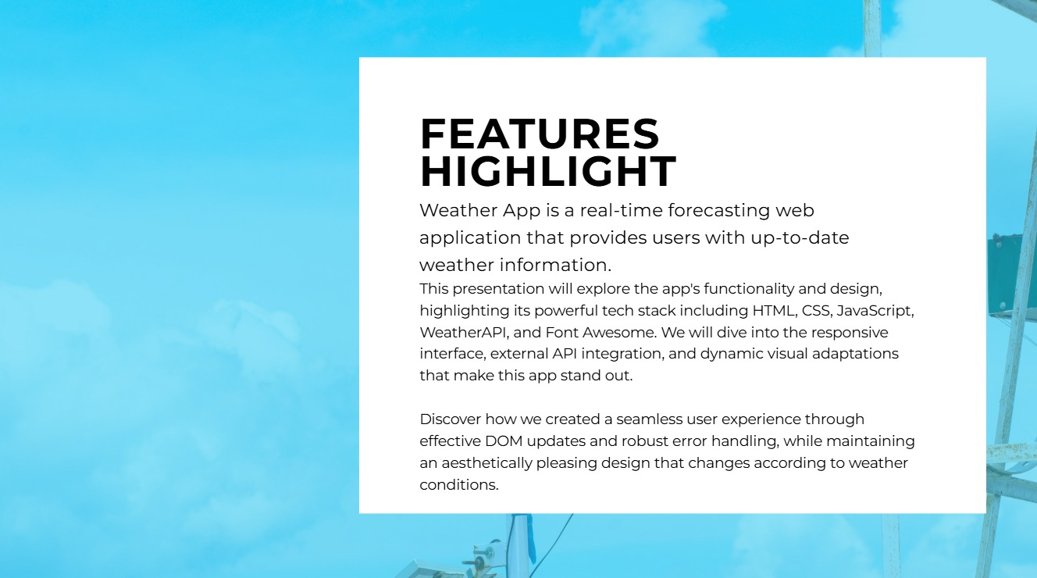

The Weather app

Slide 7
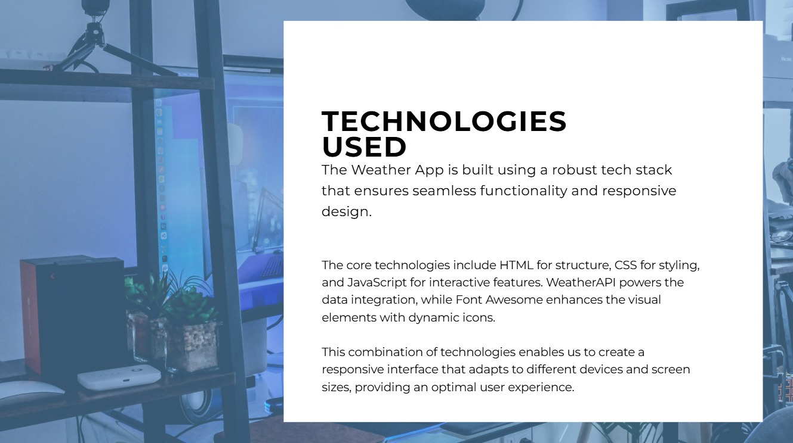

Slide 8
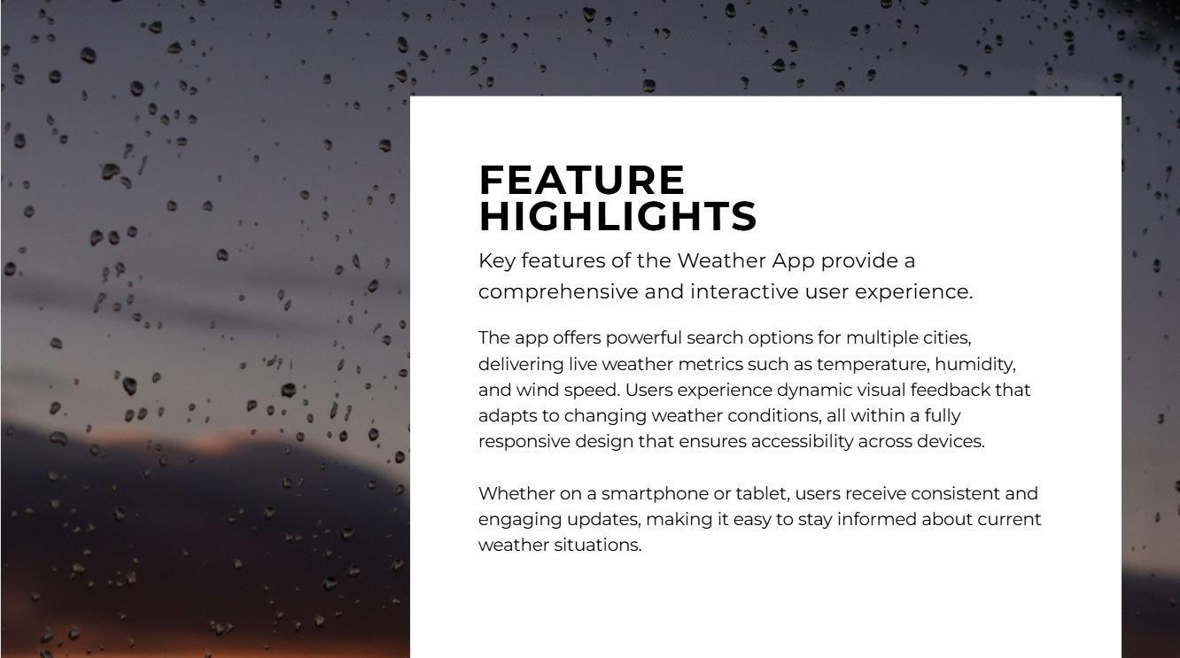

Slide 9
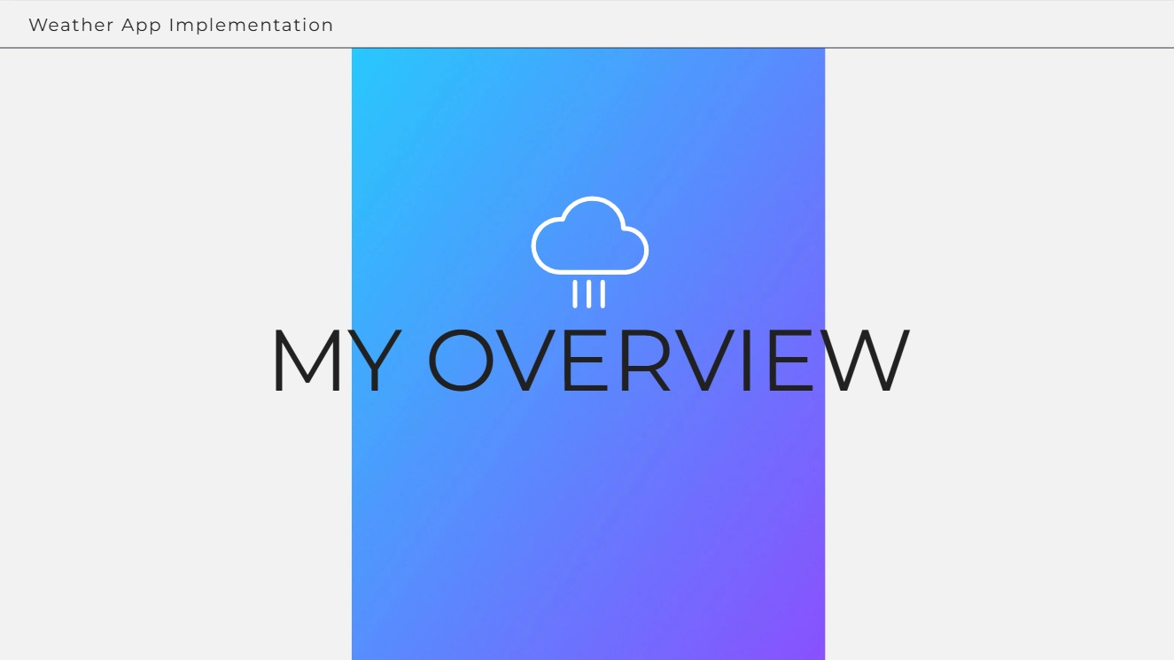

Slide 10
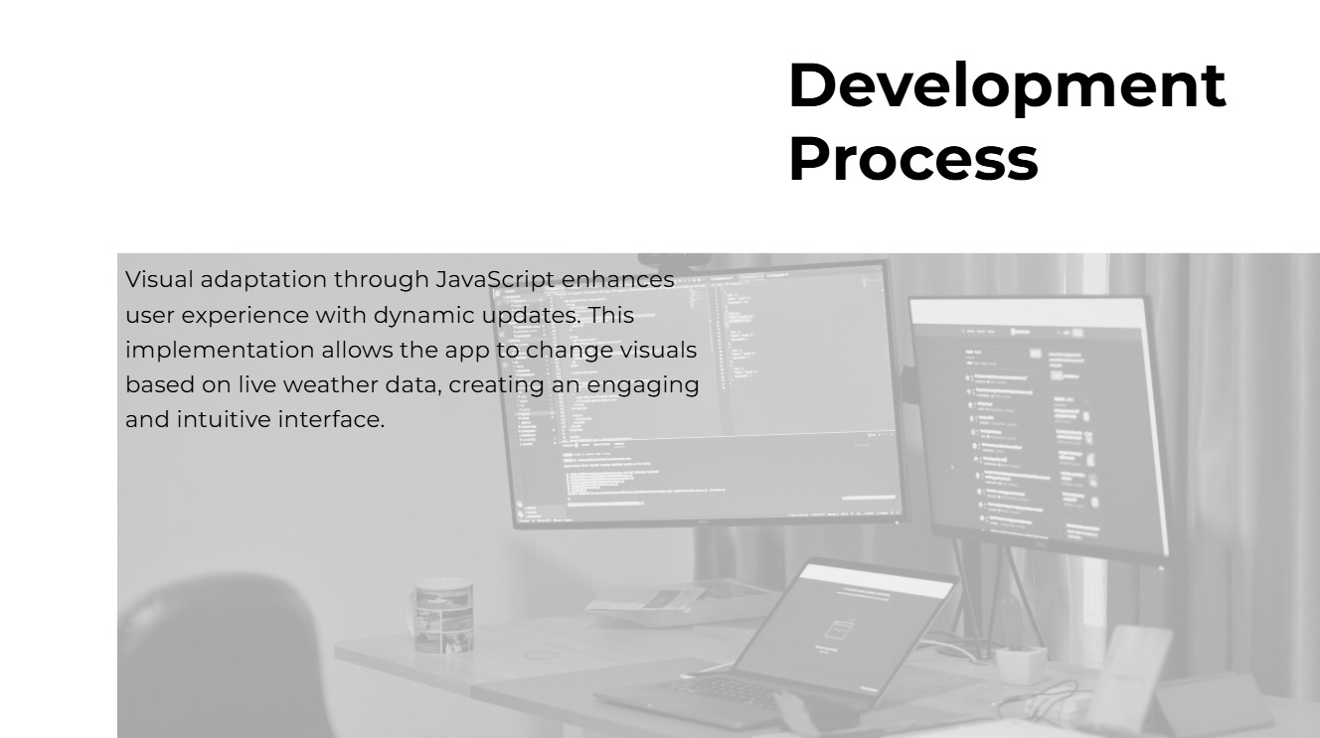

Slide 11
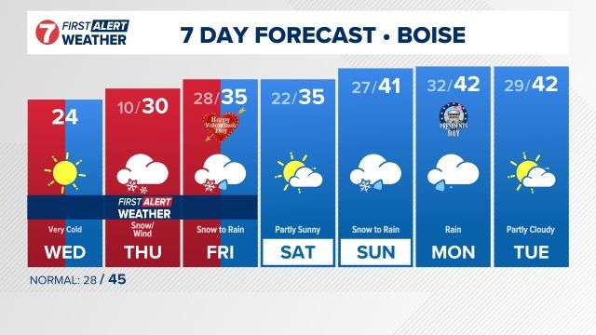
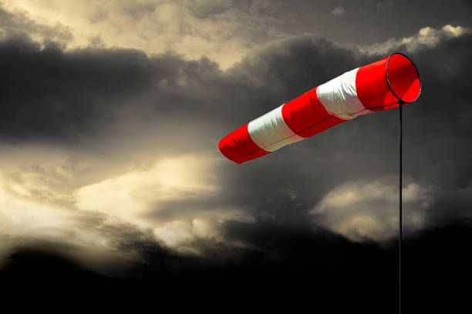
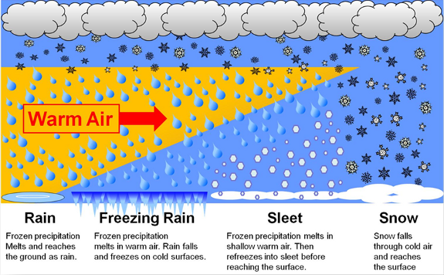
Function of the App
7 DAYS weather prediction
Temperature of each day
Windspeed
Humidity level
Precipitation level

Slide 12
WHAT’S NEW?

Slide 13
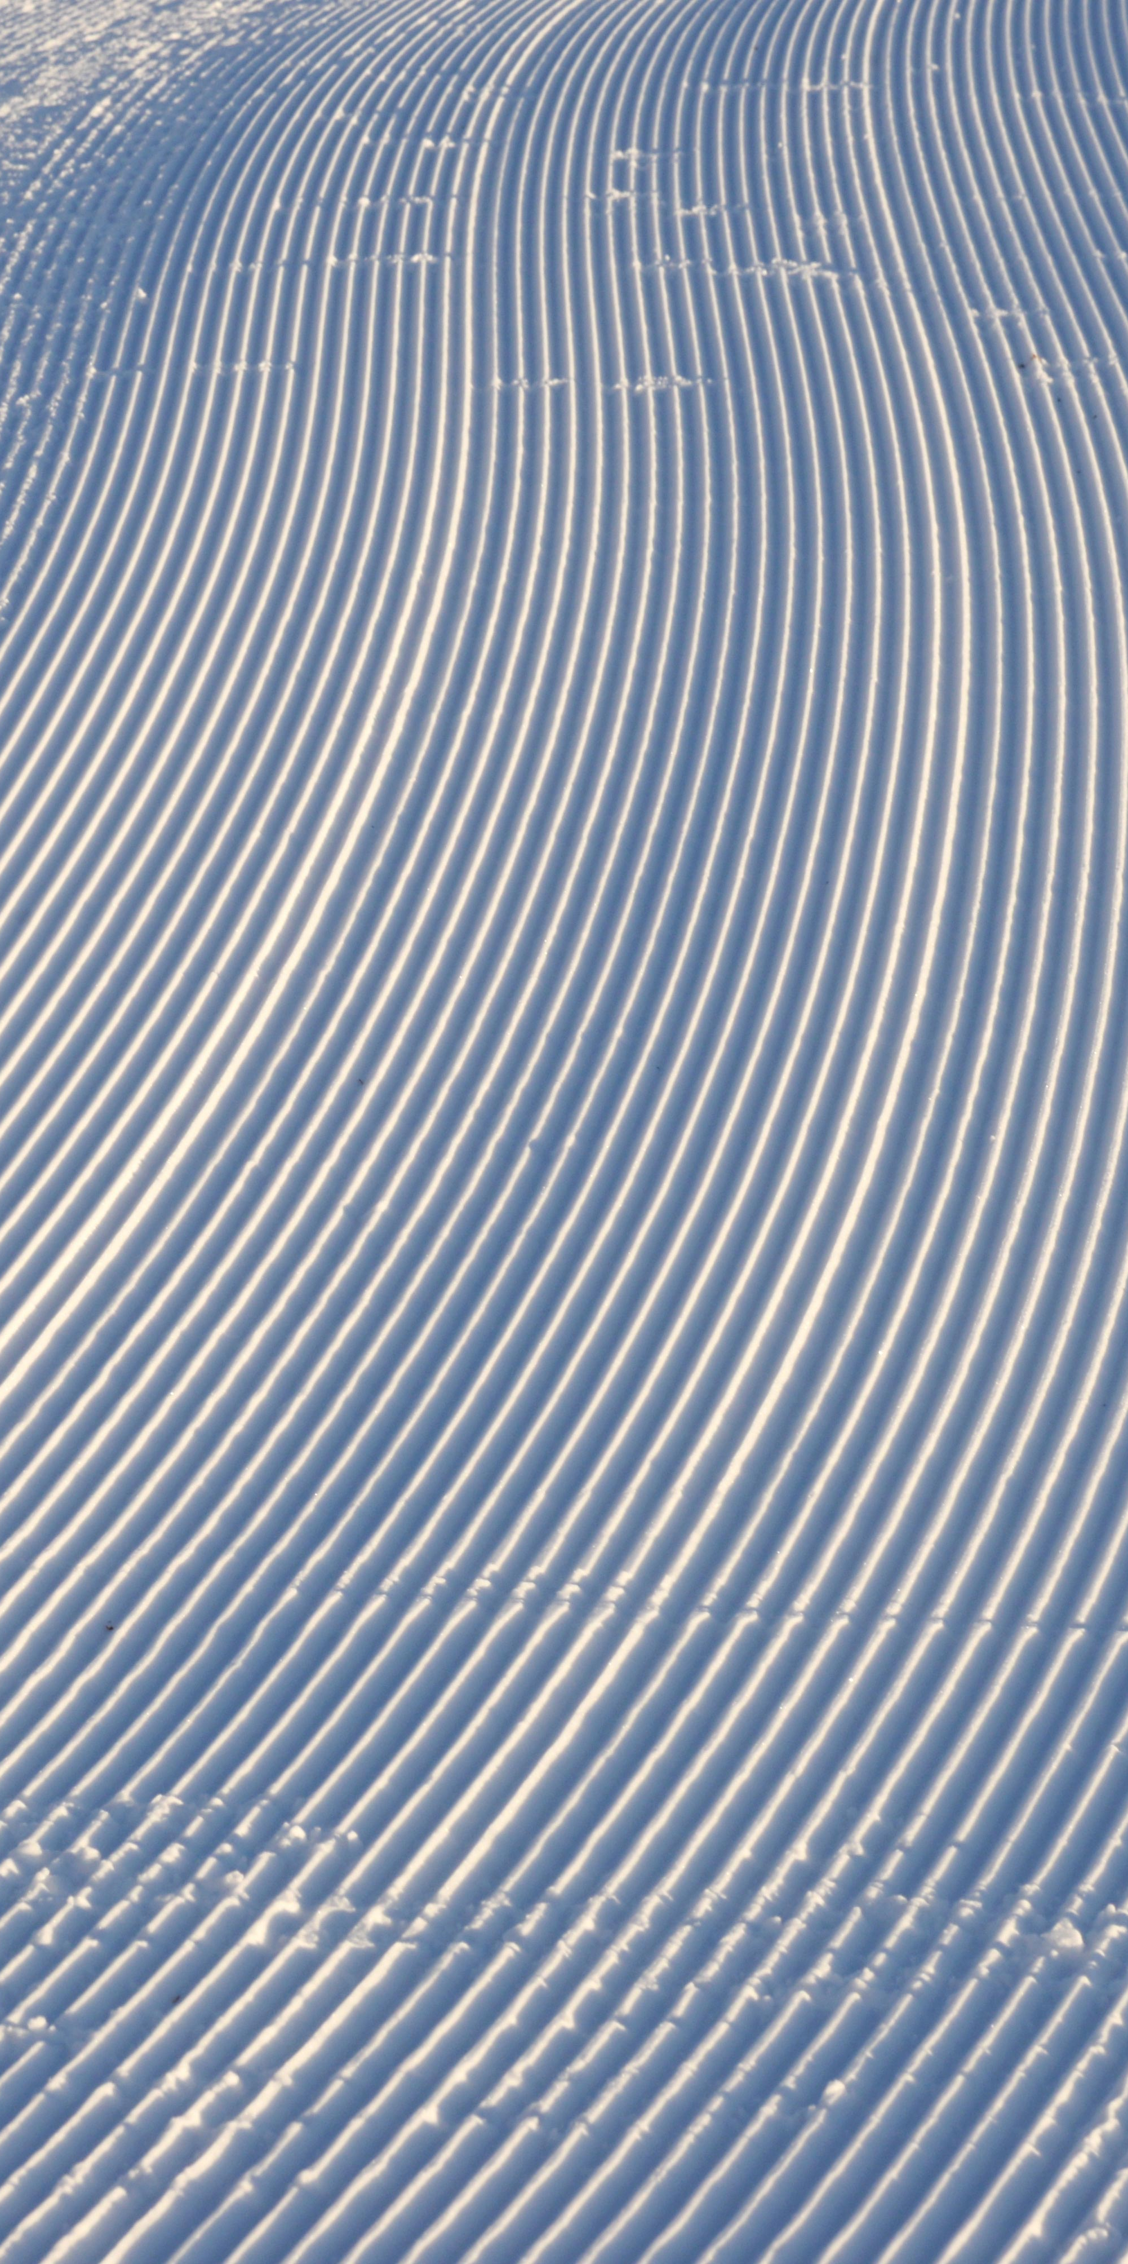
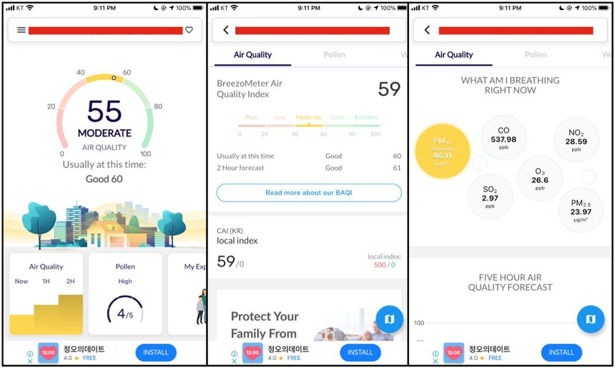
AQI METER
An Air Quality Index (AQI) meter measures the quality of air and provides a color-coded scale to indicate the level of pollution. The AQI scale includes six color-coded categories, each corresponding to a range of index values, from green for good air quality (0 to 50) to maroon for hazardous air quality .

Slide 14
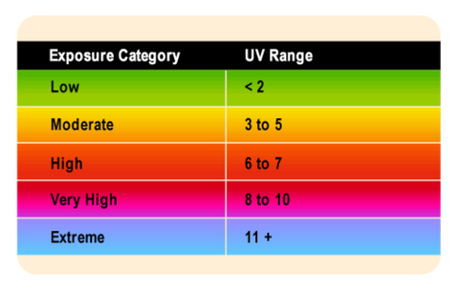
Uv ray meter
A UV rays meter, also known as a UV light meter or radiometer, measures the intensity of ultraviolet light in a specific area. These meters are useful for monitoring UV levels in environments where high UV exposure can cause damage, such as in laboratories, museums, or industrial settings

Slide 15
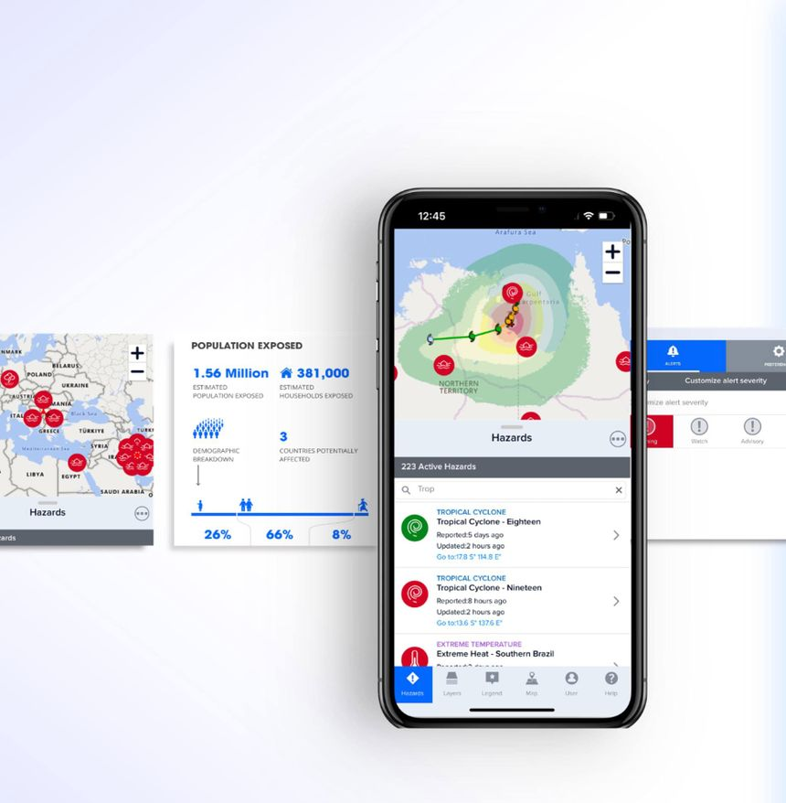
Disaster Alerts
With the weather app, you can receive real-time d and emergency alerts from the National Weather Service

Slide 16
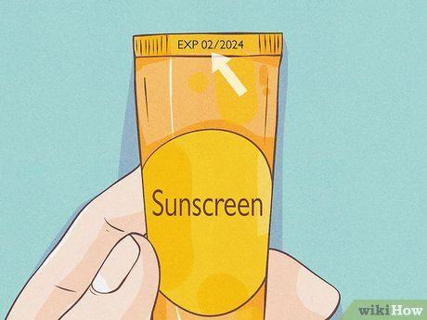
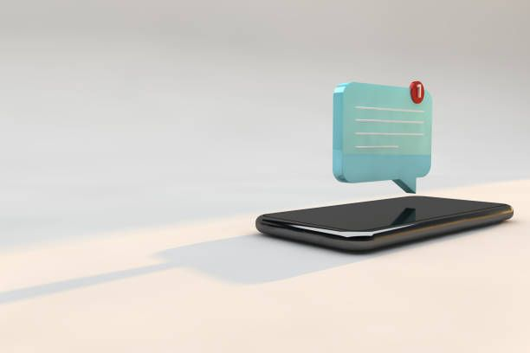
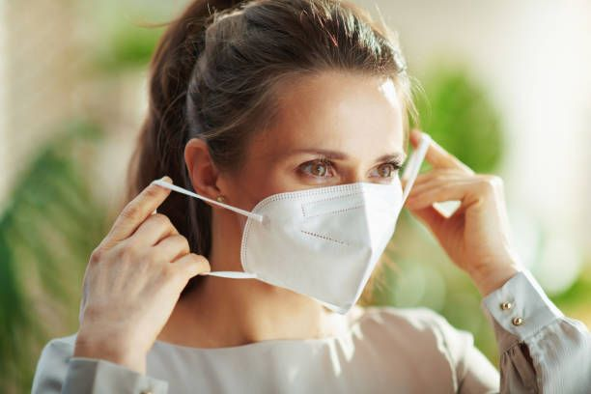

Personalized updates------------------------
Our application provides personalized notifications to help you stay prepared for various weather and environmental conditions. For example,
If rain is expected within the next hour or during a specific time of the day, you will receive a timely reminder to carry an
umbrella.
On sunny days, our UV rays meter will notify you to apply sunscreen before heading out.
Additionally, if the air quality index (AQI) is too high, we will recommend either staying indoors or wearing a mask when going outside.

Slide 17
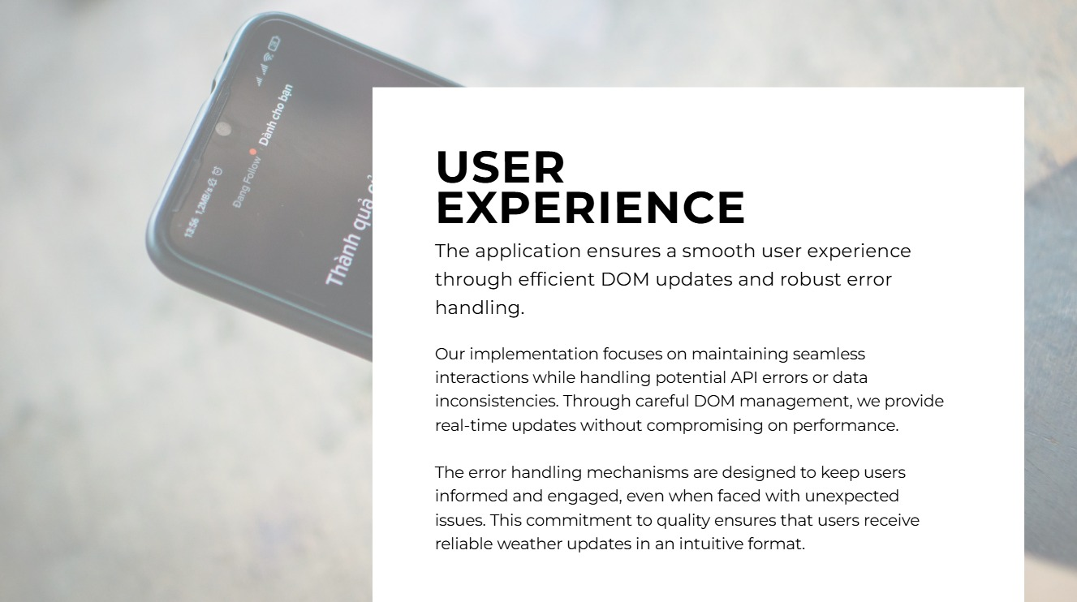

Slide 18
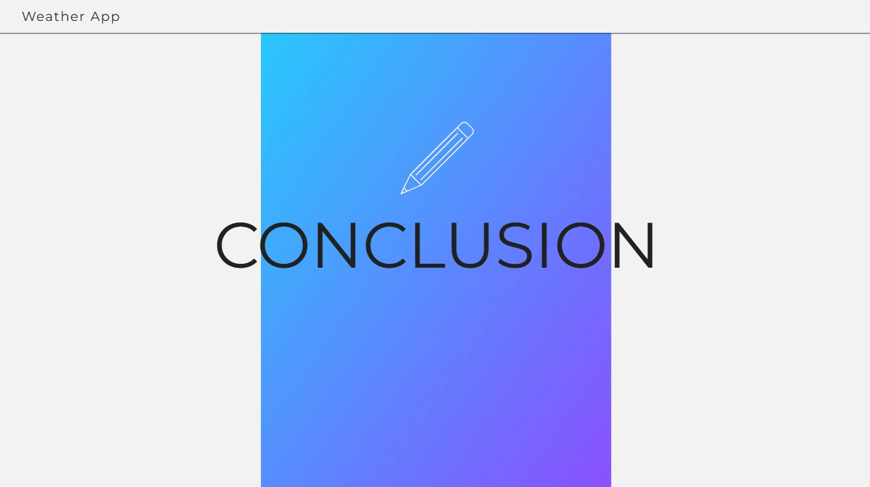

Slide 19
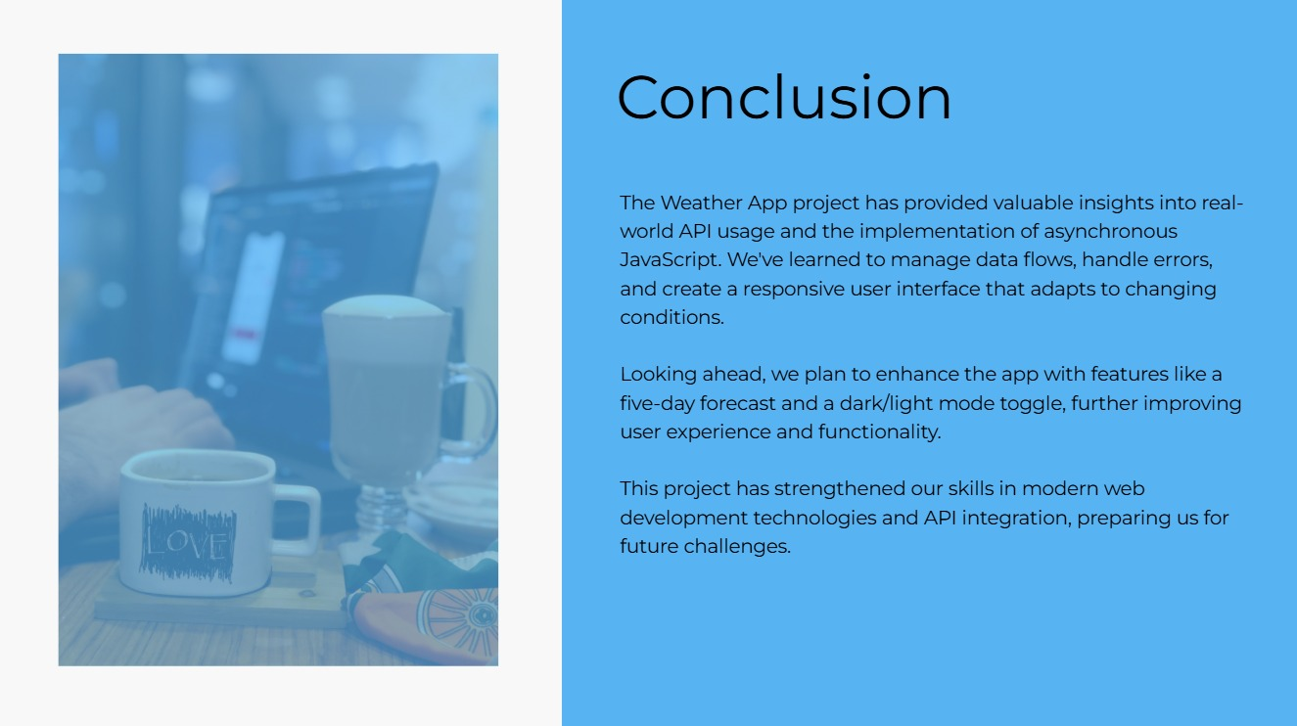

Slide 20
